Slide 1
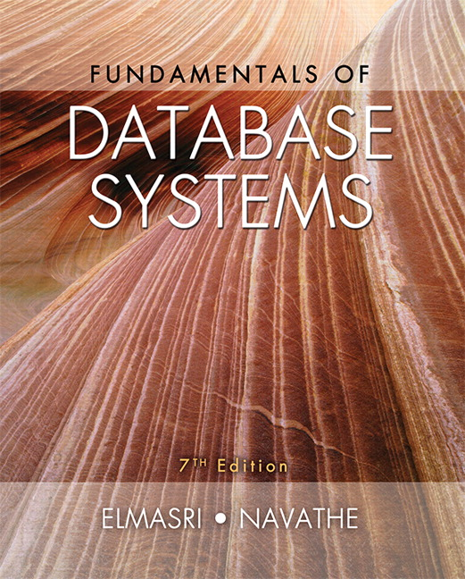

Slide 2
CHAPTER 20
Introduction to Transaction Processing Concepts and Theory

Slide 3
Introduction
Transaction
Describes local unit of database processing
Transaction processing systems
Systems with large databases and hundreds of concurrent users
Require high availability and fast response time

Slide 4
20.1 Introduction to Transaction Processing
Single-user DBMS
At most one user at a time can use the system
Example: home computer
Multiuser DBMS
Many users can access the system (database) concurrently
Example: airline reservations system

Slide 5
Introduction to Transaction Processing (cont’d.)
Multiprogramming
Allows operating system to execute multiple processes concurrently
Executes commands from one process, then suspends that process and executes commands from another process, etc.

Slide 6
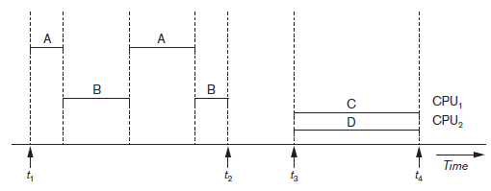
Introduction to Transaction Processing (cont’d.)
Interleaved processing
Parallel processing
Processes C and D in figure below
Figure 20.1 Interleaved processing versus parallel processing of concurrent transactions

Slide 7
Transactions
Transaction: an executing program
Forms logical unit of database processing
Begin and end transaction statements
Specify transaction boundaries
Read-only transaction
Read-write transaction

Slide 8
Database Items
Database represented as collection of named data items
Size of a data item called its granularity
Data item
Record
Disk block
Attribute value of a record
Transaction processing concepts independent of item granularity

Slide 9
Read and Write Operations
read_item(X)
1. Find the address of the disk block that contains item X.
2. Copy that disk block into a buffer in main memory (if that disk block is not already in some main memory buffer). The size of the buffer is the same as the disk block size.
3. Copy item X from the buffer to the program variable named X.

Slide 10
Read and Write Operations
write_item(X)
1. Find the address of the disk block that contains item X.
2. Copy that disk block into a buffer in main memory (if that disk block is not already in some main memory buffer).
3. Copy item X from the program variable named X into its correct location in the buffer.
4. Store the updated disk block from the buffer back to disk (either immediately or at some later point in time).

Slide 11
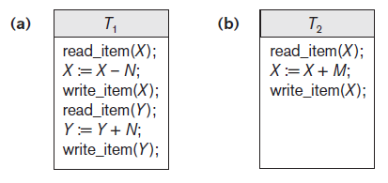
Read and Write Operations (cont’d.)
Read set of a transaction
Set of all items that a transaction read.
Write set of a transaction
Set of all items written
Example: Read and write set of T1 are : {X,Y}, {X,Y}
Read and write set of T2 are : {X}, {Y}
Figure 20.2 Two sample transactions (a) Transaction T1 (b) Transaction T2

Slide 12
DBMS Buffers
DBMS will maintain several main memory data buffers in the database cache
When buffers are occupied, a buffer replacement policy is used to choose which buffer will be replaced
Example policy: least recently used

Slide 13
Concurrency Control
Transactions submitted by various users may execute concurrently
Access and update the same database items
Some form of concurrency control is needed
The lost update problem
Occurs when two transactions that access the same database items have operations interleaved
Results in incorrect value of some database items

Slide 14
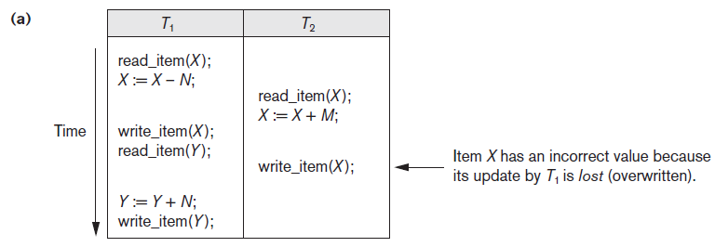
The Lost Update Problem
Occurs when two transactions that access the same database items have their operations interleaved in a way that makes the value of some database items incorrect
Example : X= 80, N=5, M=4.
What should be the value of X ?
Figure 20.3 Some problems that occur when concurrent execution is uncontrolled (a) The lost update problem

Slide 15
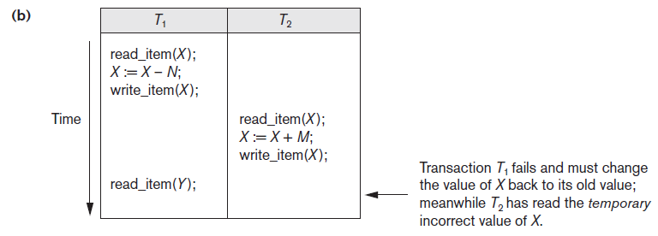
The Temporary Update Problem
One transaction updates a database item and then the transaction fails for some reason
Dirty Data
Updated item is accessed (read) by another transaction before it is changed back (or rolled back) to its original value
Figure 20.3 (cont’d.) Some problems that occur when concurrent execution is uncontrolled (b) The temporary update problem

Slide 16
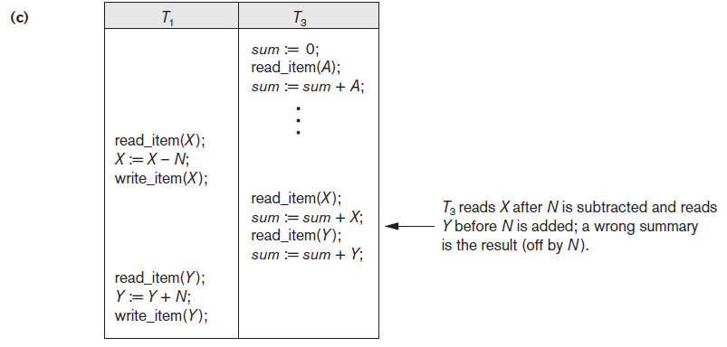
The Incorrect Summary Problem
Figure 20.3 (cont’d.) Some problems that occur when concurrent execution is uncontrolled (c) The incorrect summary problem

Slide 17
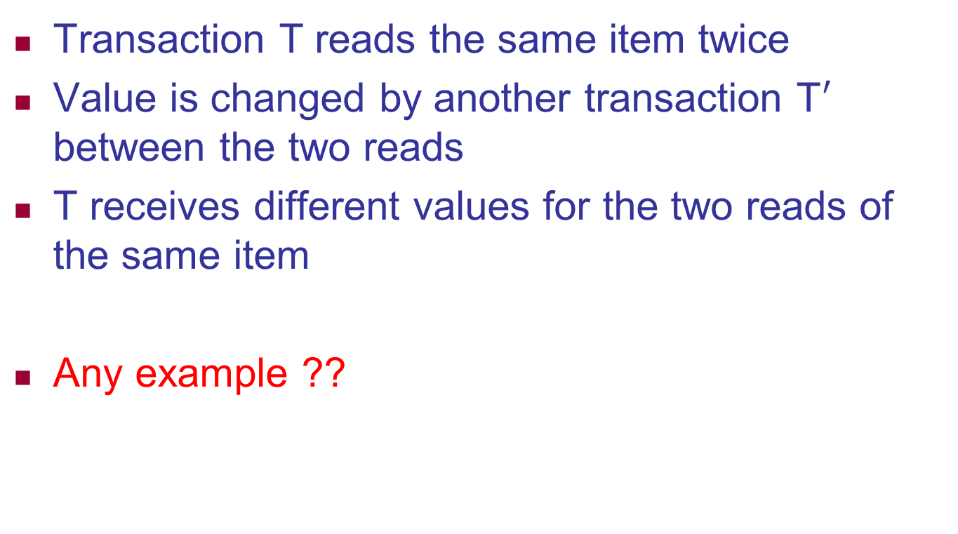
The Unrepeatable Read Problem
Transaction T reads the same item twice
Value is changed by another transaction T$′$ between the two reads
T receives different values for the two reads of the same item
Any example ??

Slide 18
Why Recovery is Needed
Committed transaction
Effect recorded permanently in the database
Aborted transaction
Does not affect the database
If a transaction fails after executing some of its operations but before executing all of them, the operations already executed must be undone and have no lasting effect.

Slide 19
Why Recovery is Needed
Types of transaction failures
1) Computer failure (system crash)
A hardware, software, or network error occurs in the computer system. e.g. main memory failure
2) Transaction or system error
Integer overflow or division by zero
Erroneous parameter values
Logical programming error
User may interrupt the transaction during its execution
3) Local errors or exception conditions detected by the transaction
data for the transaction may not be found

Slide 20
Why Recovery is Needed (cont’d.)
Types of transaction failures (cont’d.)
4) Concurrency control enforcement
Serializibility Violation
Resolving deadlock state among several transactions
5) Disk failure
Lose their data because of a read or write
Malfunction or because of a disk read/write head crash
6) Physical problems or catastrophes (power or air-conditioning failure, fire, theft, sabotage, overwriting disks or tapes by mistake)
System must keep sufficient information to recover quickly from the failure
Note : Disk failure or other catastrophes have long recovery times

Slide 21
20.2 Transaction and System Concepts
System must keep track of when each transaction starts, terminates, commits, and/or aborts
BEGIN_TRANSACTION
beginning of transaction execution
READ or WRITE
specify read or write operations on the database items
END_TRANSACTION
specifies that READ and WRITE transaction operations have ended and marks the end of transaction execution
COMMIT_TRANSACTION
Signals a successful end of the transaction
Changes (updates) executed by the transaction can be safely committed to the database and will not be undone
ROLLBACK (or ABORT)
Transaction has ended unsuccessfully, any changes or effects that the transaction may have applied to the database must be undone

Slide 22
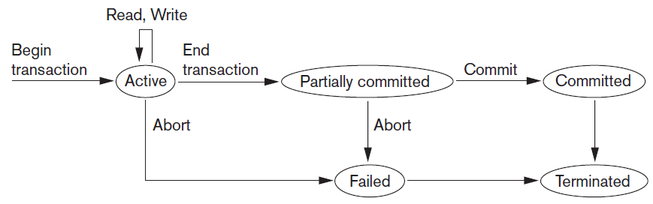
Transaction and System Concepts (cont’d.)
Figure 20.4 State transition diagram illustrating the states for transaction execution

Slide 23
The System Log
System log keeps track of transaction operations
Helps to recover from failures that affect transactions
Sequential, append-only file
Not affected by failure (except disk or catastrophic failure)
Log buffer (Main Memory Buffer)
hold the last part of the log file, log entries are first added to the log main memory buffer
When full, appended to end of log file on disk
Log file is backed up periodically
Undo and redo operations based on log possible

Slide 24
The System Log Entries
[start_transaction, T]
Indicates that transaction T has started execution.
[write_item, T, X, old_value, new_value]
Indicates that transaction T has changed the value of database item X from old_value to new_value.
[read_item, T, X]
Indicates that transaction T has read the value of database item X.
[commit, T]
Indicates that transaction T has completed successfully, and affirms that its effect can be committed (recorded permanently) to the database.
[abort, T]
Indicates that transaction T has been aborted.

Slide 25
Commit Point of a Transaction
Occurs when all operations that access the database have completed successfully
And effect of operations recorded in the log
Transaction writes a commit record into the log
If system failure occurs, can search for transactions with recorded start_transaction but no commit record
Force-writing the log buffer to disk
Writing log buffer to disk before transaction reaches commit point

Slide 26
DBMS-Specific Buffer Replacement Policies
Page replacement policy
Selects particular buffers to be replaced when all are full
Domain separation (DS) method
Each domain handles one type of disk pages
Index pages
Data file pages
Log file pages
Number of available buffers for each domain is predetermined
Page replacement handled via the basic LRU (least recently used) page replacement

Slide 27
DBMS-Specific Buffer Replacement Policies (cont’d.)
Hot set method
Useful in queries that scan a set of pages repeatedly
Does not replace the set in the buffers until processing is completed .
For example, when a join operation is performed using the nested-loop method
If the inner loop file is loaded completely into main memory buffers without replacement (the hot set)
Join will be performed efficiently because each page in the outer loop file will have to scan all the records in the inner loop file to find join matches.

Slide 28
20.3 Desirable Properties of Transactions
ACID properties
Atomicity
Transaction performed in its entirety or not at all
Consistency preservation
Completely executed from beginning to end without interference from other transactions
Takes database from one consistent state to another
Isolation
Not interfered with by other transactions
Durability or permanency
Changes applied by committed transaction must persist in the database

Slide 29
Desirable Properties of Transactions (cont’d.)
Levels of isolation
Level 0 isolation does not overwrite the dirty reads of higher-level transactions
Level 1 isolation has no lost updates
Level 2 isolation has no lost updates and no dirty reads
Level 3 (true) isolation has repeatable reads
In addition to level 2 properties
Snapshot isolation

Slide 30
20.4 Characterizing Schedules Based on Recoverability
Schedule or history
Order of execution of operations from all transactions
Operations from different transactions can be interleaved in the schedule
Total ordering of operations in a schedule
For any two operations in the schedule, one must occur before the other

Slide 31
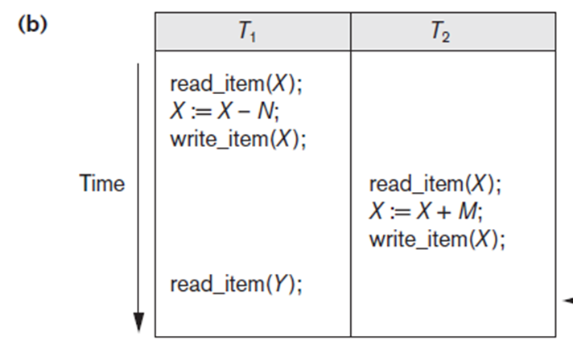
20.4 Characterizing Schedules Based on Recoverability
Schedule or history

Slide 32
Characterizing Schedules Based on Recoverability (cont’d.)
Two conflicting operations in a schedule
Operations belong to different transactions
Operations access the same item X
At least one of the operations is a write_item(X)
Two operations conflict if changing their order results in a different outcome
Read-write conflict
r1(X); w2(X) to w2(X); r1(X)
Write-write conflict
w1(X); w2(X) to w2(X); w1(X)

Slide 33
Characterizing Schedules Based on Recoverability (cont’d.)
Two conflicting operations in a schedule
Operations belong to different transactions
Operations access the same item X
At least one of the operations is a write_item(X)
For example, in schedule Sa, conflicting operations
r1(X) and w2(X) conflict
operations r2(X) and w1(X)
operations w1(X) and w2(X)
What about :
r1(X) and r2(X) ?
w2(X) and w1(Y) ?
r1(X) and w1(X) ?

Slide 34
Characterizing Schedules Based on Recoverability (cont’d.)
Recoverable schedules
Recovery is possible
Nonrecoverable schedules should not be permitted by the DBMS
No committed transaction ever needs to be rolled back
Cascading rollback may occur in some recoverable schedules
Uncommitted transaction may need to be rolled back

Slide 35
Characterizing Schedules Based on Recoverability (cont’d.)
Cascadeless schedule
Avoids cascading rollback
Strict schedule
Transactions can neither read nor write an item X until the last transaction that wrote X has committed or aborted
Simpler recovery process
Restore the before image

Slide 36
20.5 Characterizing Schedules Based on Serializability
Serializable schedules
Always considered to be correct when concurrent transactions are executing
Places simultaneous transactions in series
Transaction T₁ before T₂, or vice versa

Slide 37
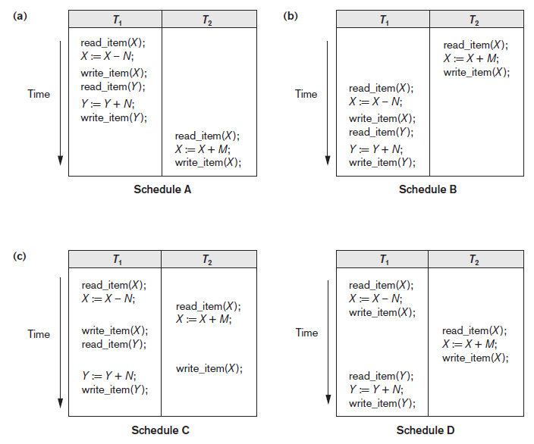
Figure 20.5 Examples of serial and nonserial schedules involving transactions T1 and T2 (a) Serial schedule A: T1 followed by T2 (b) Serial schedule B: T2 followed by T1 (c) Two nonserial schedules C and D with interleaving of operations

Slide 38
Characterizing Schedules Based on Serializability (cont’d.)
Problem with serial schedules
Limit concurrency by prohibiting interleaving of operations
Unacceptable in practice
Solution: determine which schedules are equivalent to a serial schedule and allow those to occur
Serializable schedule of n transactions
Equivalent to some serial schedule of same n transactions

Slide 39
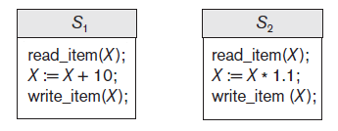
Characterizing Schedules Based on Serializability (cont’d.)
Result equivalent schedules
Produce the same final state of the database
May be accidental
Cannot be used alone to define equivalence of schedules
Figure 20.6 Two schedules that are result equivalent for the initial value of X = 100 but are not result equivalent in general

Slide 40
Characterizing Schedules Based on Serializability (cont’d.)
Conflict equivalence
Relative order of any two conflicting operations is the same in both schedules
Serializable schedules
Schedule S is serializable if it is conflict equivalent to some serial schedule S’.

Slide 41
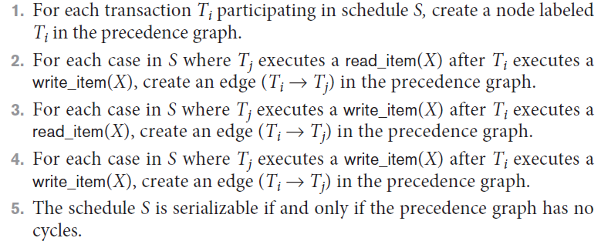
Characterizing Schedules Based on Serializability (cont’d.)
Testing for serializability of a schedule
Algorithm 20.1 Testing conflict serializability of a schedule S

Slide 42
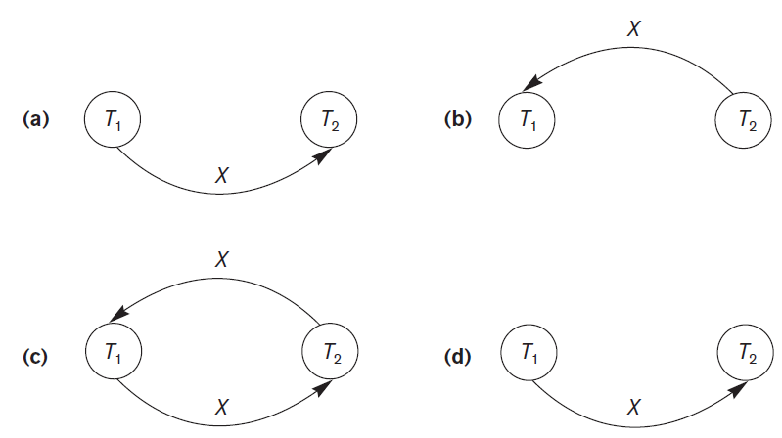
Characterizing Schedules Based on Serializability (cont’d.)
Figure 20.7 Constructing the precedence graphs for schedules A to D from Figure 20.5 to test for conflict serializability (a) Precedence graph for serial schedule A (b) Precedence graph for serial schedule B (c) Precedence graph for schedule C (not serializable) (d) Precedence graph for schedule D (serializable, equivalent to schedule A)

Slide 43
How Serializability is Used for Concurrency Control
Being serializable is different from being serial
Serializable schedule gives benefit of concurrent execution
Without giving up any correctness
Difficult to test for serializability in practice
Factors such as system load, time of transaction submission, and process priority affect ordering of operations
DBMS enforces protocols
Set of rules to ensure serializability

Slide 44
View Equivalence and View Serializability
View equivalence of two schedules
As long as each read operation of a transaction reads the result of the same write operation in both schedules, the write operations of each transaction must produce the same results
Read operations said to see the same view in both schedules
View serializable schedule
View equivalent to a serial schedule

Slide 45
View Equivalence and View Serializability (cont’d.)
Conflict serializability similar to view serializability if constrained write assumption (no blind writes) applies
Unconstrained write assumption
Value written by an operation can be independent of its old value
Debit-credit transactions
Less-stringent conditions than conflict serializability or view serializability

Slide 46
20.6 Transaction Support in SQL
No explicit Begin_Transaction statement
Every transaction must have an explicit end statement
COMMIT
ROLLBACK
Access mode is READ ONLY or READ WRITE
Diagnostic area size option
Integer value indicating number of conditions held simultaneously in the diagnostic area

Slide 47
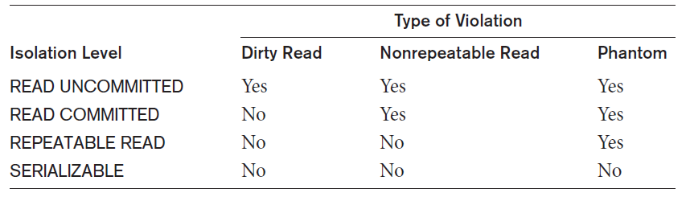
Transaction Support in SQL (cont’d.)
Isolation level option
Dirty read
Nonrepeatable read
Phantoms
Table 20.1 Possible violations based on isolation levels as defined in SQL

Slide 48
Transaction Support in SQL (cont’d.)
Snapshot isolation
Used in some commercial DBMSs
Transaction sees data items that it reads based on the committed values of the items in the database snapshot when transaction starts
Ensures phantom record problem will not occur

Slide 49
20.7 Summary
Single and multiuser database transactions
Uncontrolled execution of concurrent transactions
System log
Failure recovery
Committed transaction
Schedule (history) defines execution sequence
Schedule recoverability
Schedule equivalence
Serializability of schedules

